Slide 1
VLSI DESIGN
Lecture 4
B.E (ECE) 5th semester

Slide 2
Doping and Impurities
In order to fabricate the semiconductor devices, a controlled amount of impurities has to be introduced (doped) selectively into the single crystal wafers.
Three basic methods used for controlled doping of a semiconductor:
Epitaxy
Diffusion
Ion Implantation

Slide 3
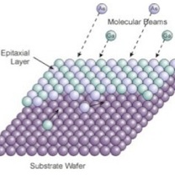
Epitaxy
Epitaxy refers to a type of crystal growth or material deposition in which new crystalline layers are formed with a well-defined orientation with respect to the crystalline substrate. The new layers formed are called the epitaxial film or epitaxial layer.

Slide 4
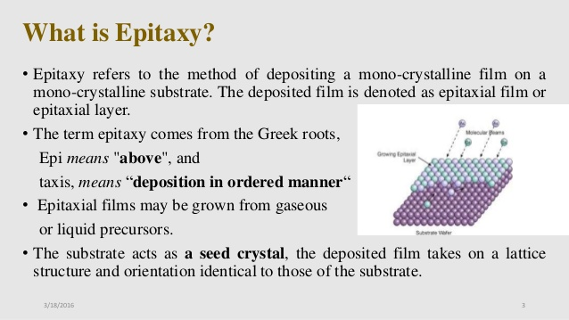

Slide 5
Types of epitaxial films or layers
There are basically two types of epitaxy:
Homo epitaxy: The film and the substrate are the same material (Si/Si, GaAs/GaAs).
Hetero epitaxy: Film and substrate are of different materials (AlAs on GaAs). Trying to grow a layer of different material on top of substrate leads to unmatched lattice parameters. This may cause srained or relaxed growth and can lead to interfacial defects.

Slide 6
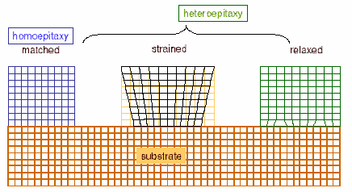

Slide 7
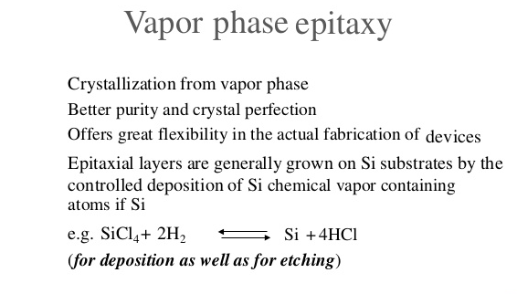
Epitaxy is further classified into:
Vapour phase epitaxy (VPE)
Liquid phase epitaxy (LBE)
Molecular beam epitaxy (MBE)

Slide 8
Vapour Phase Epitaxy
The epitaxial layer is formed from the gaseous vapour phase, hence it is called VPE.
The four important compounds for Vapour Phase Epitaxy Process reaction are silicon tetrachloride (SiCl4), trichlorosilane (SiHCl3), dichlorosilane (SiH2Cl2) and silane (SiH4). Out of these compounds, silicon tetrachloride (SiCl4) is the compound used widely in the industries.

Slide 9
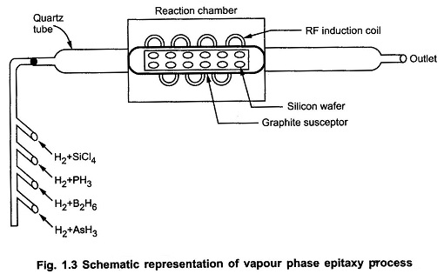
Doping is done using hydrides of arsenic, boron, phosphorous. In general, the film grows at 1 μm/min typically.

Slide 10
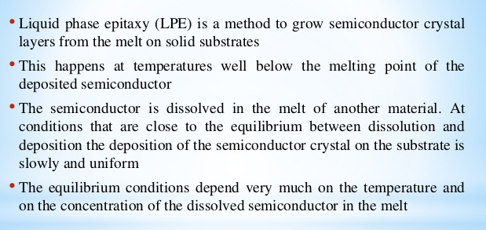
Liquid Phase Epitaxy

Slide 11
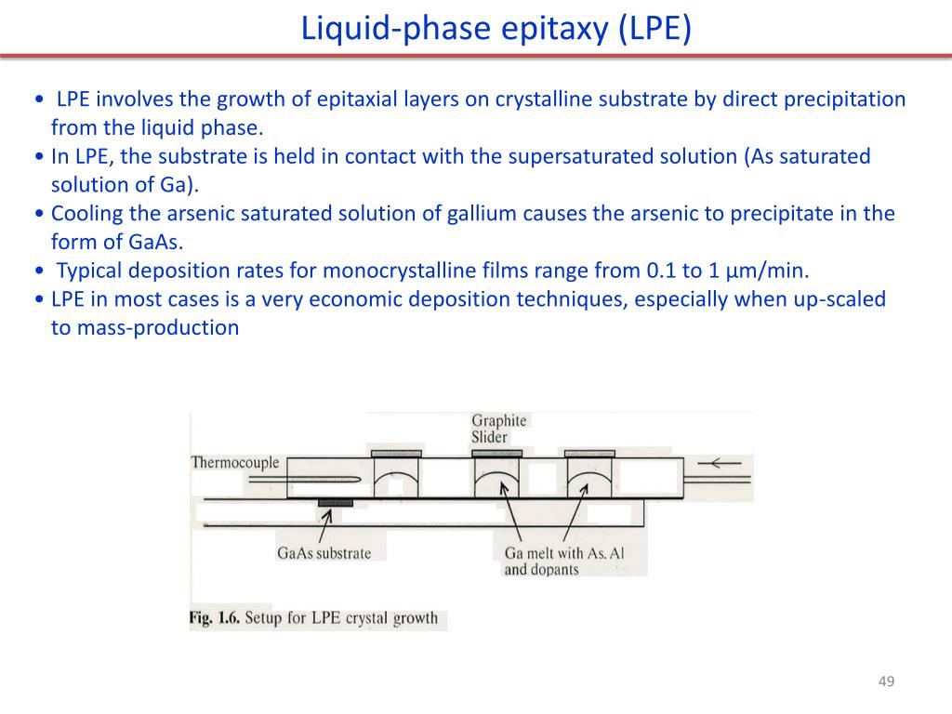

Slide 12
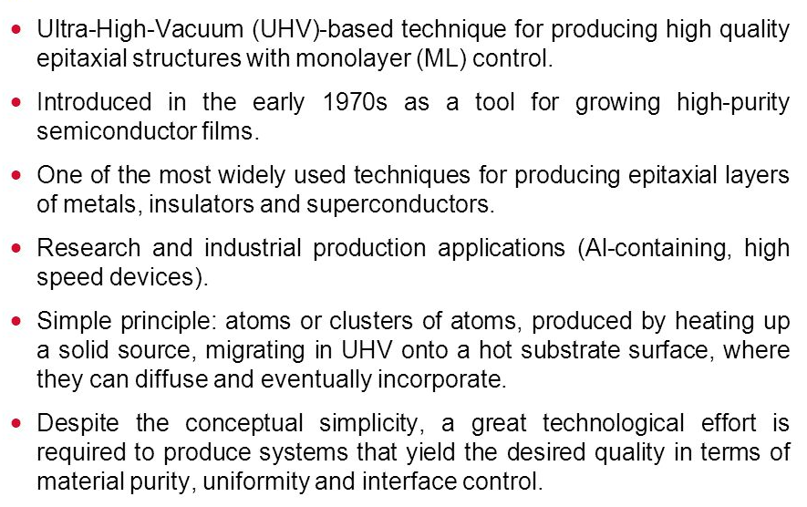
Molecular Beam Epitaxy

Slide 13
